Slide 1

International relations terms and theories
Dr. Hasan Muhammad Baniamin

Slide 2
International relations (IR)
The discipline …concerned with the factors and the activities which affect the external policies and power of the basic units into which the world is divided (Hoffman, 1977).
As a situation, IR describes the state of interaction between two or more actors in separate national boundaries.
These include all or any aspects of their relationship such as war, conflict, dispute, separation, belligerency, settlement, pact, treaties, cooperation, conferences, and organization.
As a principle, IR refers to a set of ideas that constitute the public policy that a state makes for the purpose of the external context.

Slide 3
Approaches to the Study of IR
Approaches to the study of IR refer to the ways by which issues in international politics are viewed. These are
  Idealism
  Realism, and
  Liberalism

Slide 4
Idealism
The idealist approach is that which strengthens the view that international politics is not about a theatre of war.
It regards the relationship that exists between states as one that does not necessarily create disorder and descent into anarchy.
The idealist school is premised on the Wilsonian theory that peace and order can reign in an international system of politics, that is, where there are conscious and sustained efforts to maintain order.
Man as a social being is thus a moral being, and with law to guide the relations and control boundaries, coupled with education which nourishes and ennobles the soul, as well as the presence of a system of law, man can live without anarchy.

Slide 5
Realism
Realism is the IR school that is pessimistic about moral suasion in international politics.
The realist argument begins with the natures of politics and man.
Politics, which principally means the determination of who gets what, when and how, or the authoritative allocation (sharing) of values (resources), gives little or no room for morality or best behaviour.
Man is by nature selfish and aggressive, and on a matter that involves the sharing of scarce resources over which all are contending, law and order or moral consciousness would be the last recourse.

Slide 6
Liberalism
Liberalist approach in international politics flows from the broad liberal ideology which tends to describe the international system as a group of states and non-state actors whose inevitable mutual interdependence ultimately requires social, legal and economic order for states to fully realize their goals.
The liberal school tends to have some aspects of both the realist and idealist schools.
The liberal paradigm agrees with the notion of vulnerability of the international system because of conflicting interests, but sees the need for the establishing of law and order coupled with the organization of states into groups as the most effective way to avert anarchy.
The focal point of this perspective is that democratic systems are more likely to promote an international environment of peace, friendship and cooperation that will promote a prosperous commerce and trade.
To strengthen this kind of auspicious environment, a legal system is required which can be best achieved by international grouping.

Slide 7
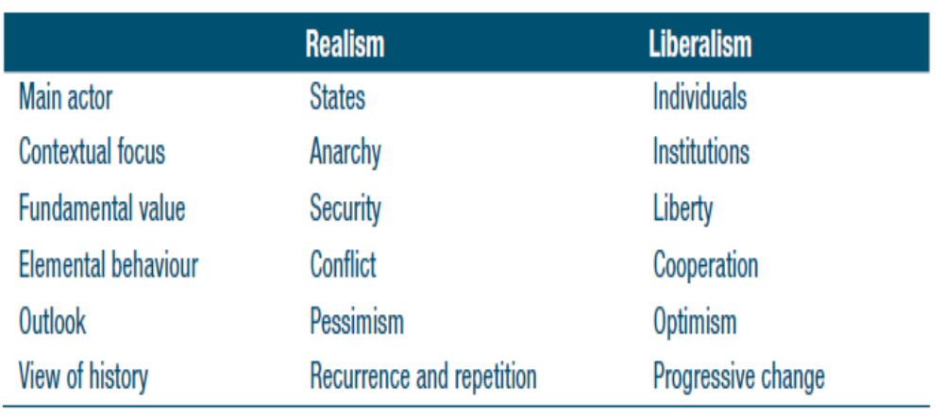
Realism and liberalism compared

Slide 8
Diplomacy
Diplomacy
  the art of conducting relations (treaties, external trade, peacemaking, war, issues of environment, culture and external representation) through polite, non-hurtful manner on behalf of a state through the engagement of professionals.
  Track One diplomacy is what diplomats do—formal negotiations between nations conducted by professional diplomats.
  Track Two diplomacy is unofficial, non-structured interaction. It refers to conflict resolution efforts by professional non-governmental conflict resolution practitioners and theorists.

Slide 9
Level of Analysis Problem in IR
Levels of analysis are categories of generalization or abstraction to help understand the complex problems in international politics.
There are three main frameworks namely, individual, state and international levels of analysis.

Slide 10
Individual
Individual: This is the level that holds moral principles of individuals may translate into that of nations and form of government.
The moral principles of Napoleon Bonaparte for instance, transcended the French society as it became the political system of Continental Europe at a point.
Woodrow Wilson’s ideals became the core values for democratic governments and indeed the international system from 1920.

Slide 11
State
State: It locates its explanation at the level of the state, rather than the international system.
Its argument begins with the fact that inter-national politics itself bears the tag “nation” or state, and as such world politics is characterized by the behaviour of (state) units, whose actions (national interests, national roles, national security, national power, among other quests), determine the happenings in the global system.
The inactions of states (such as watching without intervening while the Rwandan Holocaust was going on) could also shape international and the domestic politics of states.
The unit level of analysis is strengthened by the fact that all non-state actors (including even global organizations as the UN) do not exist outside state boundaries.

Slide 12
International
International: This is the level that holds that it is the nature of the international system that determines the behaviour of states and the attitudes of leaders or governments.
The anarchy of the international system thus becomes compelling factor for states to pursue power and act amorally in the course of self-preservation.

Slide 13
Basic Concepts in IR
Foreign Policy: This refers to a set of principles that guide the conduct of a nation’s external relations.
National Interest: This refers to the strategic goals of a state in international politics. It is embedded in the country’s foreign policy and actualized through diplomacy and other instruments.
Chequebook diplomacy is a type of diplomacy based economic aid and investment in the bilateral relations between countries.

Slide 14
Basic Concepts in IR
National Role Conception: This refers to policy makers’ articulation of the content of the state actions in international politics in order to gain desired mileage and strategic advantage over other states.
Balance of power: It indicates that national security is guaranteed when military capabilities are distributed in such a way that no single state strong enough to dominate or threaten the security of others.
  The contention is that when there is a military hegemon among states, it will take advantage of its strength on weaker ones, which makes it imperative for weaker states to unite in a defensive coalition.
  As such, there will be relative stability in a potentially anarchic international system when there is equilibrium or balance of power among potentially aggressive configurations.

Slide 15
Basic Concepts in IR
Instruments of State Policy: These refer to the means or strategies by which states conduct their foreign policies.
  They are embedded in national role conception. These include political, economic, military, and cultural instruments.
  Political instruments include diplomacy, propaganda, summitry and conferences, alliances, treaties.
  Economic instruments include sanctions, tariffs, trade, boycott, sabotage or subversion, and embargo.
  Military instruments include war, exchange of military attaches, exchange of military knowledge, shared capacity and joint actions
  Cultural instruments: cultural centres or villages and build educational institutions in other countries.

Slide 16
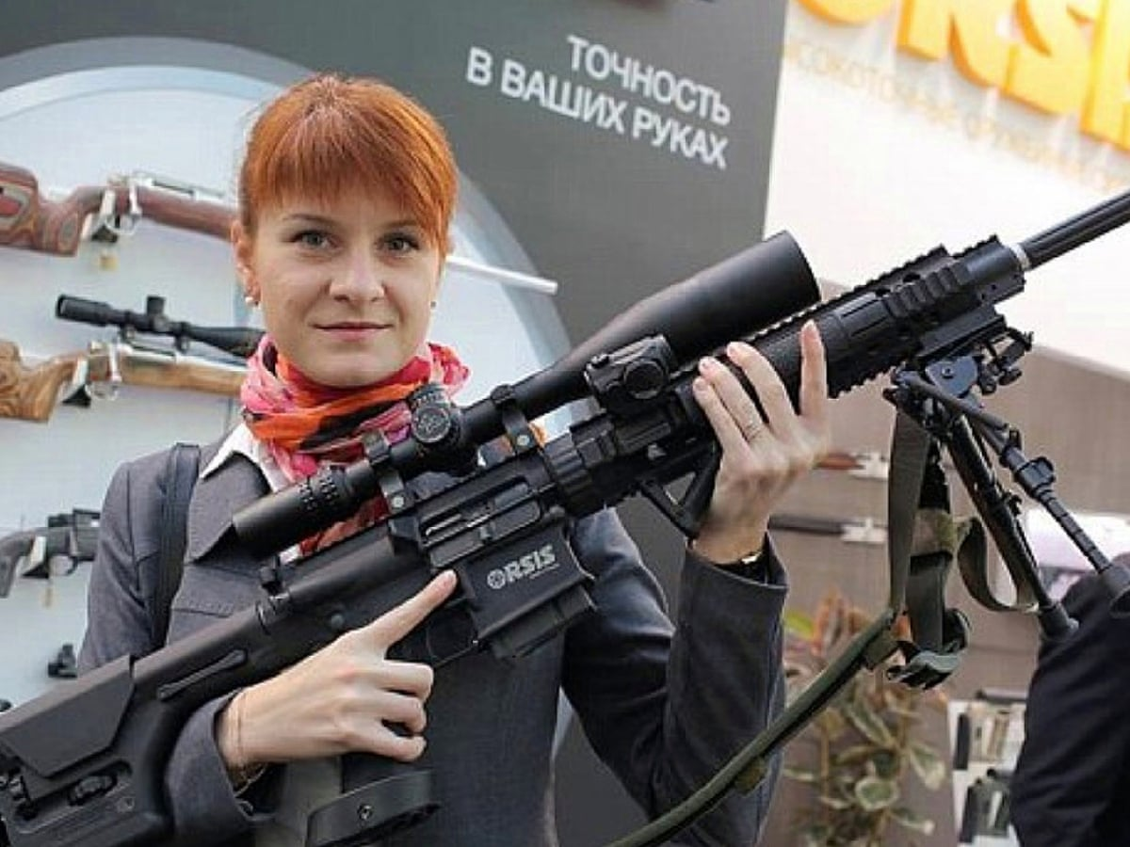
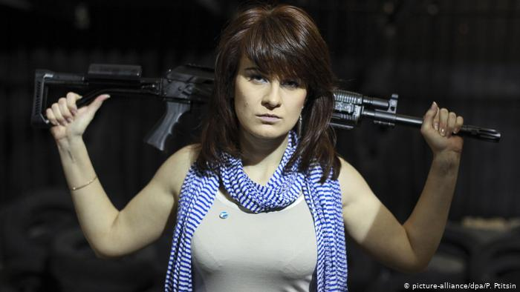
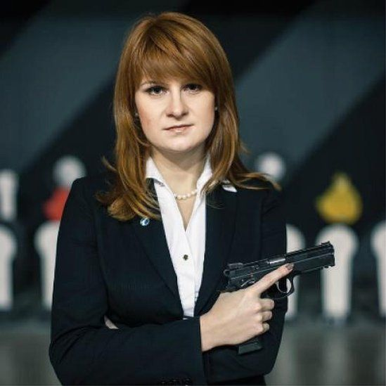
https://www.bbc.com/news/world-us-canada-44885633

Slide 17
Basic Concepts in IR
Diplomatic immunity is a form of legal immunity that ensures diplomats are given safe passage and are considered not susceptible to lawsuit or prosecution under the host country's laws, although they may still be expelled.
Modern diplomatic immunity was codified as international law in the Vienna Convention on Diplomatic Relations (1961) which has been ratified by all but a handful of nations
Persona non grata (Latin, plural: personae non gratae), literally meaning ‘an unwelcome person’; it is a status sometimes applied by a host country to foreign diplomats to remove their protection

Slide 18
Basic Concepts in IR
A buffer state is a country lying between two rival or potentially hostile greater powers. Bhutan, and Sikkim were buffer-states between the British Empire and China, later between China and India.
A satellite state is a country that is formally independent in the world, but under heavy political, economic and military influence or control from another country.

Slide 19
Basic Concepts in IR
Chatham House Rule : A rule or principle according to which information disclosed during a meeting may be reported by those present, but the source of that information may not be explicitly or implicitly identified.
Diplomatic illness is the practice amongst diplomats and government ministers by pretending to have illness, or another debilitating condition, to avoid engaging in diplomatic or social engagements

Slide 20
Basic Concepts in IR
“Hawks” are those who advocate an aggressive foreign policy based on strong military power.
“Doves” try to resolve international conflicts without the threat of force.

Slide 21
Suggested readings
Devetak, R., George, J., & Percy, S. (Eds.). (2012). An introduction to international relations. Cambridge University Press; pp. 1-61.

Slide 22
Q?

